Slide 1


4216 UK Weather Data Analysis
Tuesday 5th April 2022
Cameron Marsh, Ethan Ibrahim,
Laura J. Phillips, Luke Citrine
Luke Curren, Niamh Walsh, Shane Mendis
Cameron Marsh, Ethan Ibrahim,
Laura J. Phillips, Luke Citrine
Luke Curran, Niamh Walsh, B.I.S.U Mendis

Slide 2
















Laura
1/4
Assignment Approach
Resources
Closure & Review
Enablers /
Risks & Issues
Functionality & Scope
Plans & Comms
(UK Data covers England and Wales, only.)

Slide 3
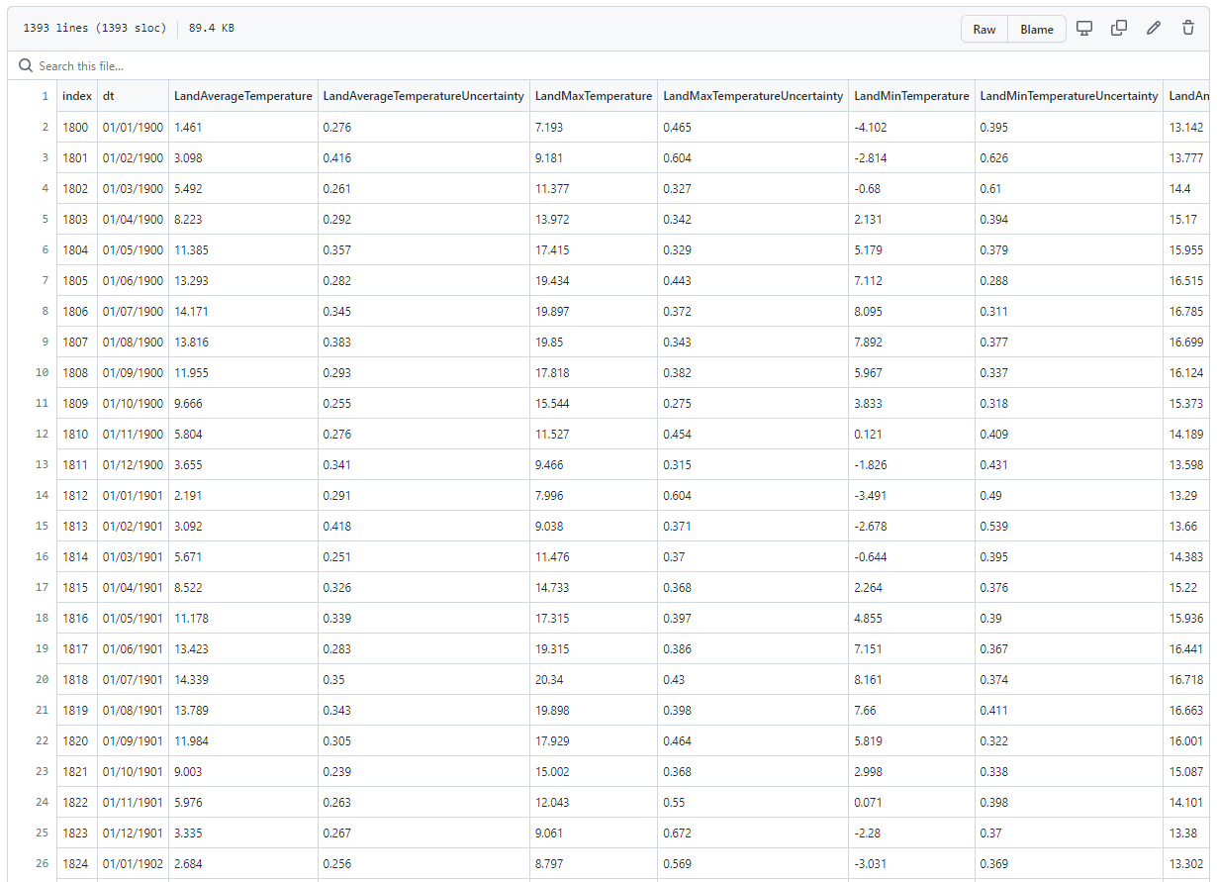
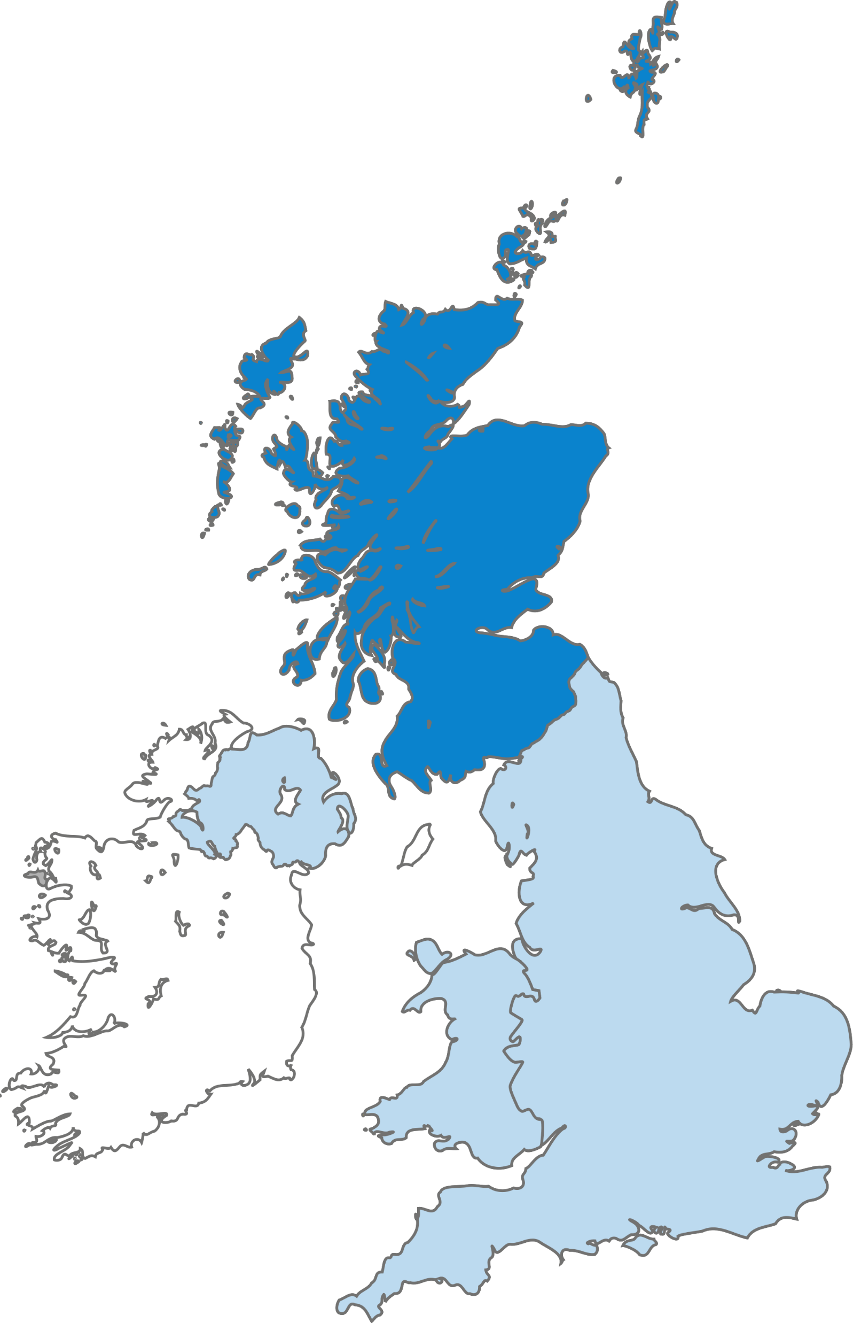

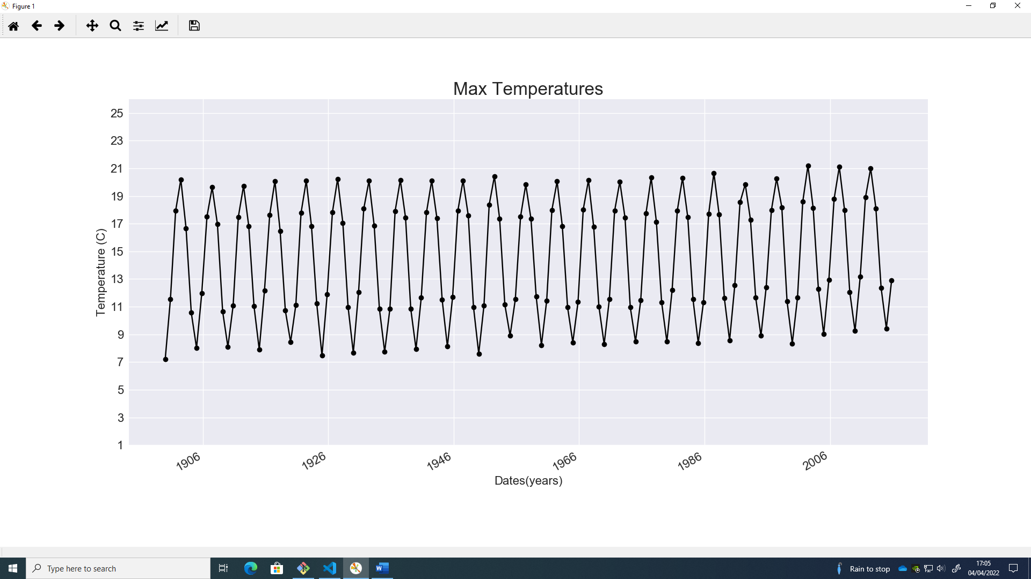
Luke Curran
2/4
This Photo by Unknown Author is licensed under CC BY-NC

Slide 4
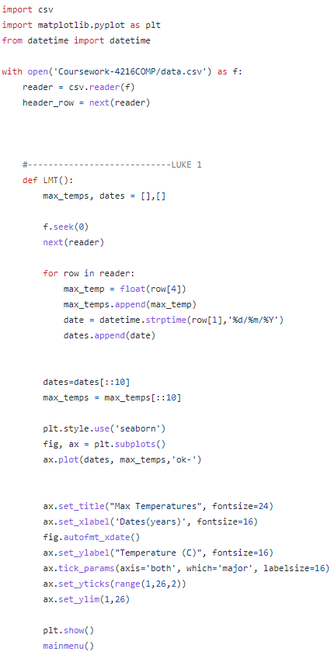
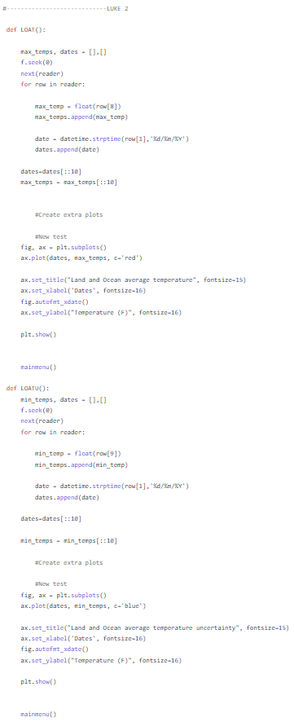
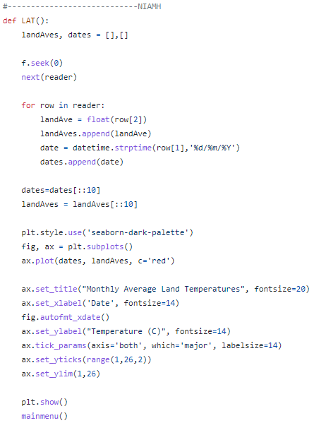
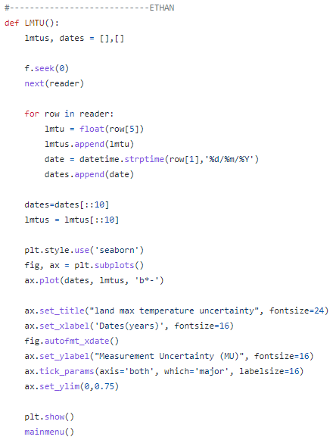


Luke Curran
Code: 1/2
Luke Citrine
3/4
Niamh
Ethan
Luke Curran

Slide 5
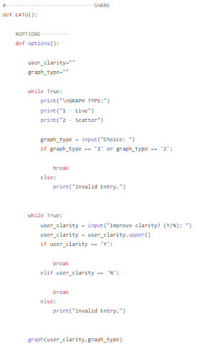
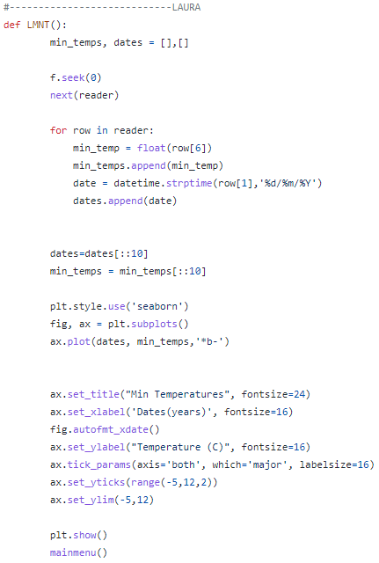
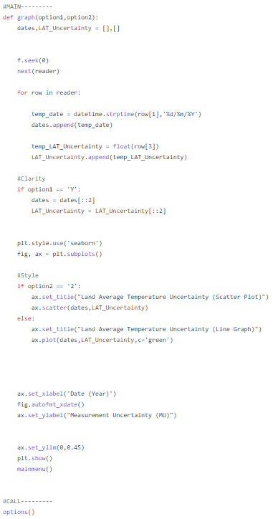

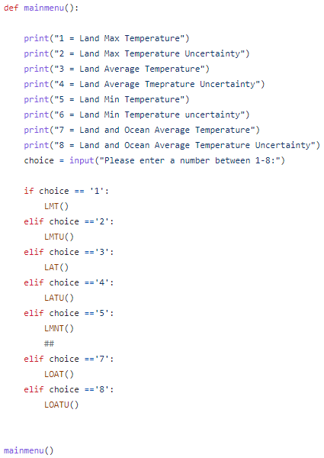


Luke Curran
Shane
Laura
Code: 1/2
4/4
End-User Input
That
went well!

Slide 6
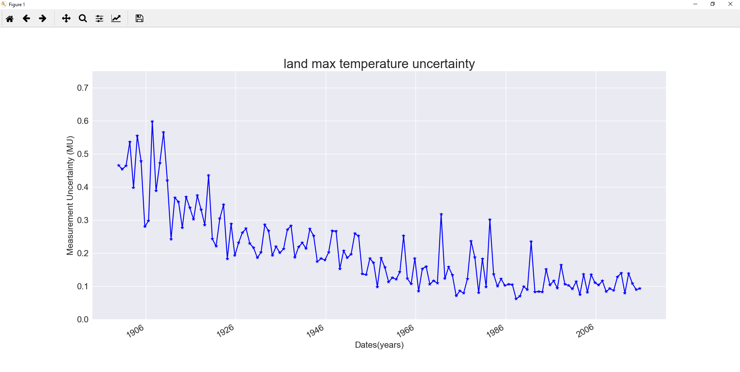


Ethan
Ethan

Slide 7
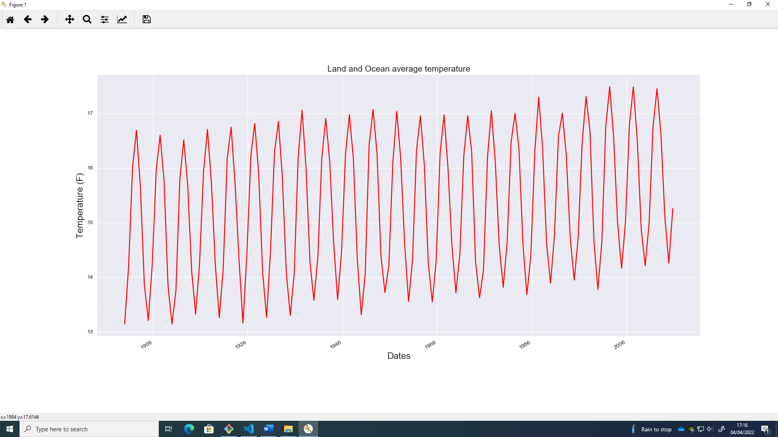
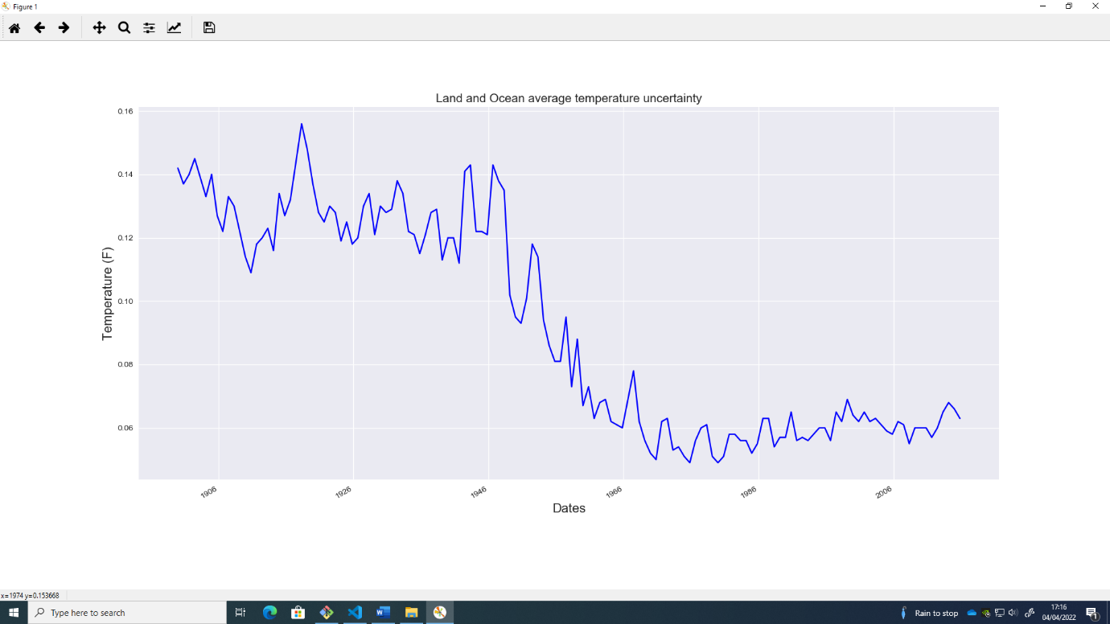

Ethan
Luke Citrine
Learning

Slide 8
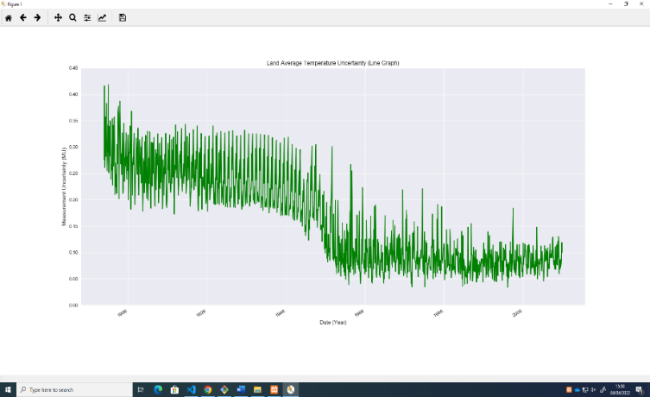

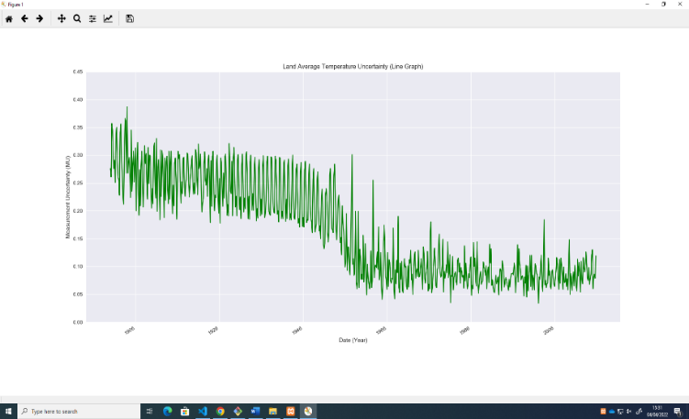
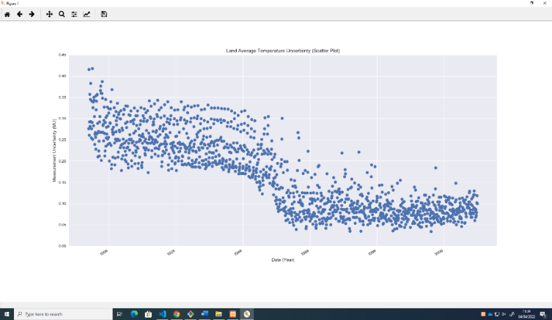

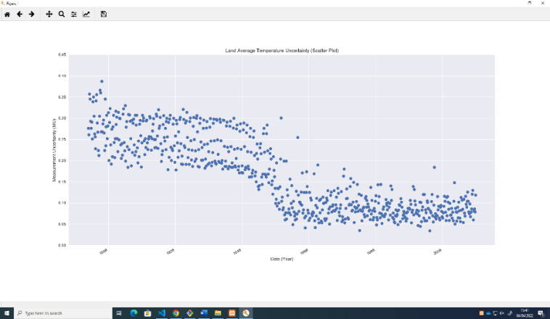
Shane
Shane
Line Graph (Full):
Line Graph (Half):
Scatter Plot (Full):
Scatter Plot (Half):

Slide 9
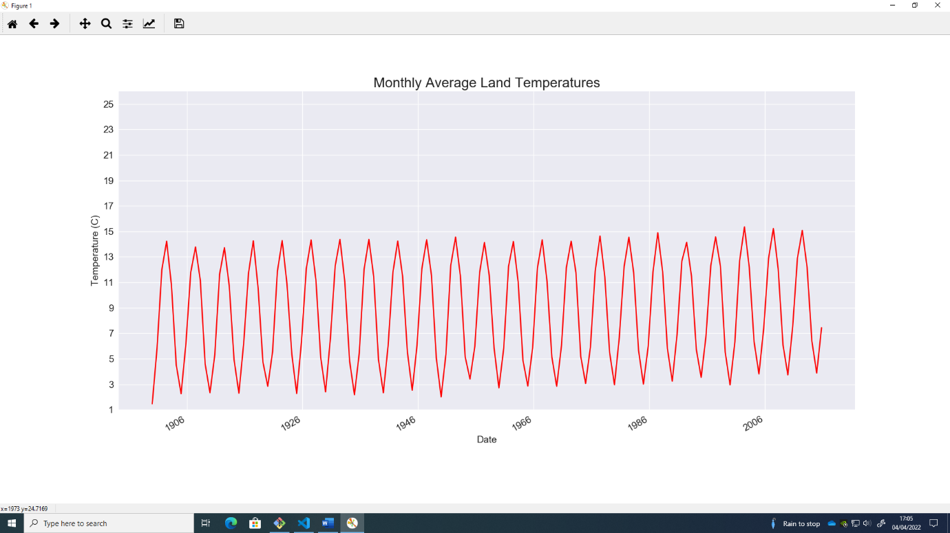

Niamh
Niamh

Slide 10
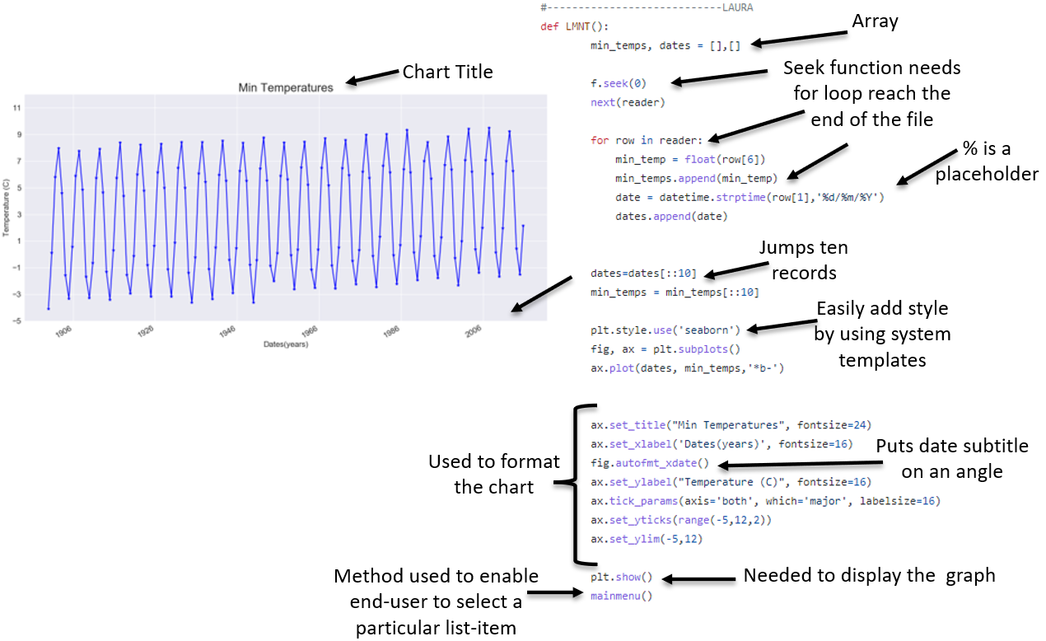

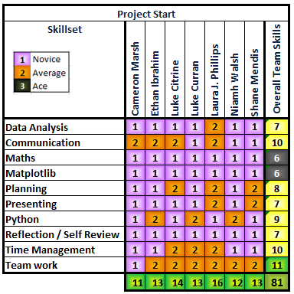
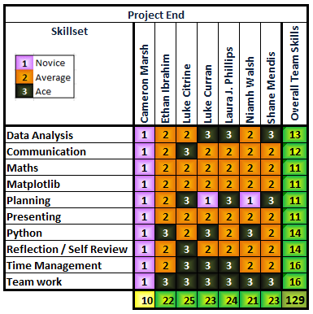
Laura
Individual and
Team Learning

Slide 11
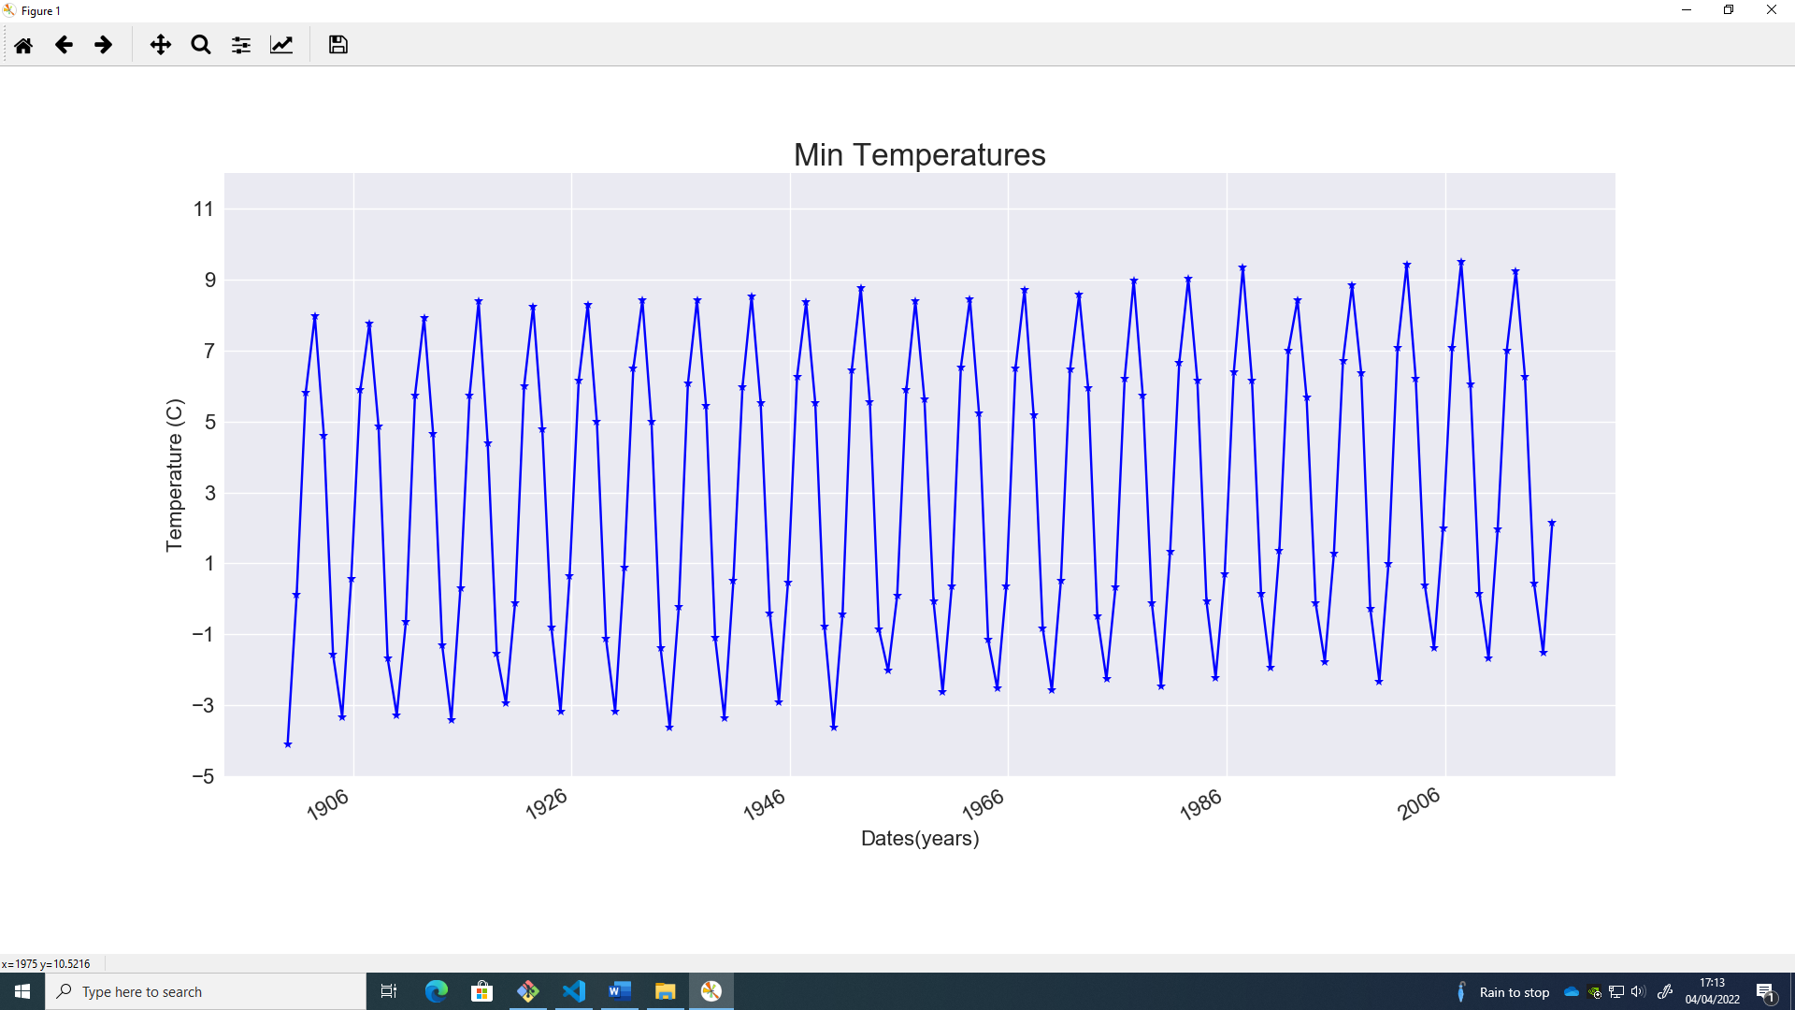
LUKE 1
Conclusion
Conclusion
Line Graph (Full):
Line Graph (Half):
Scatter Plot (Full):
Scatter Plot (Half):

Slide 12
4216 UK Weather Data Analysis
Tuesday 5th April 2022
Thanks for watching this presentation, today.
Cameron Marsh, Ethan Ibrahim,
Laura J. Phillips, Luke Citrine
Luke Curren, Niamh Walsh, Shane Mendis
Cameron Marsh, Ethan Ibrahim,
Laura J. Phillips, Luke Citrine
Luke Curran, Niamh Walsh, B.I.S.U Mendis

